Slide 1
Climate Model Output Rewriter (CMOR) Version 3
CMIP6 tables and MIPs post-processing
Monterey – December 10, 2015
Denis Nadeau

Slide 2
Content
Background
What is CMOR?
What is needed for CMIP6?
What is new in CMOR3?
CMIP6 tables for CMOR3.
What’s needed for similar projects such as obs4MIPs, ana4MIPs, CREATE?
Introduction to ezCMOR.

Slide 3
Background
What is CMOR?
Create a uniform output file from different models following the CF-1 standard format to facilitate model outputs intercomparison.
Capability to reorder axis order, reverse axis direction and convert units.
Follow CF conventions – provides for standardized description of data contained in a file.
Data Reference Syntax (DRS) – defines vocabulary used in uniquely identifying MIP datasets and specifying file and directory names
http://cmip-pcmdi.llnl.gov/cmip5/docs/cmip5_data_reference_syntax.pdf

Slide 4
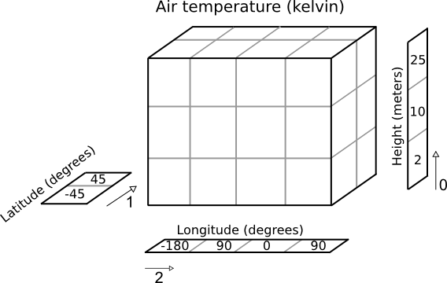
What is CMOR?
Define axes.
Define variables to be written by CMOR.
Write an array of data that includes one or more time samples for a defined variable.
1979-01-01
1979-02-01
1979-03-01
time

Slide 5
Coupled Model Intercomparison Project 6
What is needed for CMIP6?
More flexibility with global attributes.
Realization, Initialization, Physics in configuration file (table).
Allow additional “required” global attributes.
Allow user to “define” their custom global attributes.
Provide more complete QC information to CMOR.

Slide 6
Current projects for CMIP6
Gather information from different “MIP” projects for CMIP6.
Architecture of current XML database.
AerChemMIP C4MIP CFMIP CORDEX DAMIP DCPP DECK DynVar FAFMIP GMMIP GeoMIP HighResMIP | ISMIP6 LS3MIP LUMIP OMIP PDRMIP PMIP RFMIP SIMIP ScenarioMIP SolarMIP VIACSAB VolMIP

Slide 7
CMOR3 Gathering information for CMIP6 (XML)
Experiments
Variables
Expt. Group
experiment
Table
Section
Structure
spid
Spatial Shape
egid
stid
tmid
esid
expt
Temporal Shape
Request Items
MIP
Cmor
Var
Var
vid
vid
Objective
Request
Var
rlid
oid
Objective
Link
vgid
Request Links
refid
RequestVarGrp
Var
Choice
Remarks

Slide 8
CMOR3 What’s new?
Conversion of XML table to SQlite3 relational database
create table var (
uid text primary key not NULL ,
description text,
id text,
label text,
procComment text,
procNote text,
prov text,
sn text,
title text,
units text)

Slide 9
CMOR3 What’s new?
From SQL create JSON format table.
CMOR3 will read JSON format table.
“GeoMIP”: {
“Experiments”: {
"G6sulfurSlice2": {
“Variables”: {
"va": {
"modeling_realm": "atmos",
"ok_max_mean_abs": "4.679",
"ok_min_mean_abs": "0.9886”,
"levels": "17",
"timeLabel": "time-mean",
"mipTable": "Amon",
"valid_max": "69.93”,
"valid_min": "-71.1",
"frequency": "mon",
"cell_methods": "time: mean",
"timeDimension": "time",
"dimensions": "longitude|latitude|plevs”
}
}
}
}
}

Slide 10
CMOR3 What’s new?
Add new tables to better handle a wider range of model output and observational data.
Convert tables to JSON files
Allow more flexibility specially for metadata.
Add new projects for CMIP6.
Add new variables, spatial and temporal resolution.
Provide more complete Quality Control information
(e.g., valid max and min for more fields)

Slide 11
CMOR3 What’s new?
Use filename templates:
CMIP5
hfss_Amon_HadGEM2-AO_historical_r1i1p1_186001-200512.c
<variable>_<realm>_<institute>_<experiment>_<rip>_<timestamp>.nc
CMIP6
<variable_id>_<table_id>_<experiment_id>_<source_id>_<run_variant_id(rip)>_ <grid_id(regrid)>_<time_range>.nc
obs4MIPs
cltNobs_MODIS_L3_C5_200003-201109.nc
<variable>_<satellite>_<Level>_<version>_<timestamp>.nc

Slide 12
CMOR3 Workflow
MIPs: {
GeoMIP: {
Experiments: {
Variables: {
}
}
}
}
XML
Table
json
Tables
Create
Load Table
GCM Run
Write model
output files
CMOR3
Rewrite
variables
CMIP6
Files
ESGF
Publish
(Native format)

Slide 13
Introduction to ezCMOR
Collaboration with NASA Goddard Space Flight Center (NCCS)
Convert observation gridded data to CMIP file format using CMOR
Convert model reanalysis data format using CMOR.
Post-processing CMOR2 output files
Delete attributes
Realization, initialization, physics
Add attributes
Title
Set filename convention.
Set directory path convention.
Add these options to CMOR version 3 for flexibility.

Slide 14
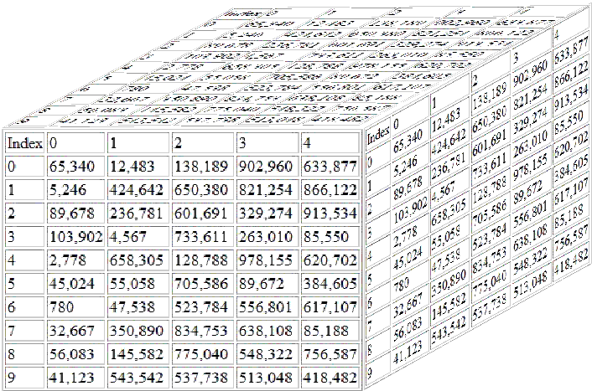
ezCMOR
Handlers
Grads/CTL
Goal:
Create time/level/lat/lon
Prepare axes for CMOR2
netCDF
Read resource files
Call CMOR
Post-processing
netCDF list
matlab
1979-01-01
1979-02-01
1979-03-01
time

Slide 15
For further information.
https://github.com/PCMDI/xml-cmor3-database
https://github.com/PCMDI/ezCMOR

Slide 16
CMOR & ezCMOR
voilà

Slide 17
ezCMOR
Variables
Variable Name | Dimension | Description | Units
T | 3D | Air Temperature | K
U | 3D | Eastward wind component | m s-1
V | 3D | Northward wind component | m s-1
TO | 3D | Ocean Temperature | K
PREC | 2D | precipitation | mm

Slide 18
ezCMOR
User variable conversion table.
CMOR Variable Name | User Variable Name | Units | Level | Positive Up/Down | Equation
ta | T | K | all |  | data
ua | U | m s-1 | all |  | data
va | V | m s-1 | all |  | data
to | TOCEAN | K | all | up | data
rsds | SWGNT | W m-2 |  | down | data
rsut | equation | W m-2 |  | up | @DIFF(SWTDN,SWTNT)
rsutc | equation | W m-2 |  | up | @DIFF(SWTDN,SWTNTCLR)
clt | CLDTOT | % |  |  | data*100
cl | CLOUD | % | all |  | data

Slide 19
ezCMOR
Resource file for monthly MERRA assimilation data.
years=1979,1980,1981
file_template = "data/instM_3d_asm_Cp_{0}.lst”
…..
inpath = "Tables"
table = 'CMIP5_Amon_createip'
inpath = 'Tables'
OutputTimeUnits = "months since 1900-1-1"
InputTimeUnits = "internal"
SetGlbAttributes = "[(\global\,rc[\product\]),
(\processing_version\,rc[\processing_version\]),
(\title\,\reanalysis output prepared for ana4MIPs
NASA-GSFC\)]"
DelGlbAttributes = "[\realization\,\experiment\,\physics_version\,\initialization_method\]"
excel_file = 'MERRA_ana4MIPs_public.xls'

Slide 20
ezCMOR
rsut | equation | W m-2 |  | up | @DIFF(SWTDN,SWTNT)
rsutc | equation | W m-2 |  | up | @DIFF(SWTDN,SWTNTCLR)
def DIFF(h, a, b):
'''
compute difference between a and b (a-b)
'''
var_a = h.getData( variable=a )
var_b = h.getData( variable=b )
res=(var_a - var_b)
return res

